Slide 1
DiffusionDesk
Diffusion models for intelligent image editing
Done by: Lee Yu Quan
Notes:
Good morning Professors. I'm Yu Quan, and I'll be presenting on my Final Year Project,
DiffusionDesk: Diffusion Models for Intelligent Image Editing

Slide 2
Agenda
01
02
03
04
05
06
Background & Motivation
Project Objectives
Literature Reviews
System Design & Implementation
Demonstration
Results & Evaluations
Notes:
I'll cover the problem and motivation, the literature behind diffusion-based
editing, how I designed and built the system, then run a demostration around the
midpoint, before closing with results, learnings, and future work.

Slide 3
Agenda (Cont)
07
08
Difficulties & Future Work
Conclusion

Slide 4
Background & Motivation
01
Notes:
Starting off with background and motivation

Slide 5
Background & Motivation
17.7%
$349.6M -> $1.08B
But four key gaps remain with existing solution:
Poor Spatial and Structural Understanding
Fragmented ecosystem — different application for different image editing task
High complexity barrier — non-expert user cannot access advanced editing
CLI / Python / local-GPU dependency — not browser-accessible
CAGR (2023 -> 2030)
AI image-generation market
(Grand View Research, 2023)
Notes:
The AI image generation market is growing 17.7% per year, but accessible unified tooling has not caught up. Current existing solutions have 4 key issues that needs to be addressed. Firstly, existing tools uses non diffusion based models to fill edited regions and they tend to lead to poor results due to poor spatial and structural understanding of the image. Secondly, different applications are required for the varying editing task. Thirdly, the learning curve of such tools are also very high for first time users. Last but not least, the hardware requirement for existing tools is also another barrier for users.

Slide 6
Project Objectives
02
Notes:
With that in mind, i present the project objective

Slide 7
Project Objectives
A unified web-based application exposing diffusion-powered editing features:
Image Inpainting
Style Transfer
Restoration
Six objectives delivered:
Unified web interface 4. Face & image restoration
Multi model inpainting 5. Non-expert UX
Diffusion based style transfer 6. Performance evaluation
Notes:
The goal of this project is to create a unified web based application that mainly provides 3 image editing features. They are image inpainting, style transfer and restoration. The web application aims to address the 4 problems highlighted. The web application will unify all 3 image editing tools, provide a simple and intuitive UI and also a responsive tool that we will measure.

Slide 8
Literature Review
03
Notes:
Moving onto the literature review

Slide 9
Literature: Diffusion Foundation
Three papers underpin every model in this project
Paper | Key Contribution | Significance
DDPM (Ho et al.2020) | Iterative denoising as image generation | The mechanism
DDIM (Song et al.2020) | Non-Markovian Sampling — 20 - 100 steps | 10-50 x speed up -> iterative
LDM (Rombach et al.2022) | Diffusion in compressed latent space | Cuts VRAM usage
FORWARD process:
Add Gaussian noise over T steps -> pure noise
REVERSE process: Learn to denoise step by step -> recover image
Notes:
The diffusion models used in this entire project are heavily dependent on this 3 main paper. Firstly, the DDPM paper main contribution was the idea of learning to reverse a noise process: forward, we add noise; backward, the model denoises step by step. The paper established this with 1000 steps. Within the same year, the DDIM paper found a Non-Markovvian Sampling way which reduces the number of steps to 20-100, making it interactive. The third paper which is the latent diffusion model paper, was the paper that managed to reduce the computation cost by moving it into a compressed latent space, allowing the larger diffusion models to run on consumer gpu which inherently have lesser VRAM.

Slide 10
Conditional Generation & Inpainting Models
Model | Architecture | Params | VRAM (FP16) | VRAM (NF4)
SD Inpainting | U-Net (LDM) | ~860M | 5-7 GB | N/A
SDXL Inpainting | U-Net (LDM) | ~2.6B | 10-12 GB | ~ 4 GB
Kandinsky 2.2 | Prior + Decoder | ~2B | 6-8 GB | N/A
FLUX.1 Fill | DiT + Flow Matching | ~12B | 22-24 GB | ~ 10 GB
Classifier-Free Guidance
Ho - 2022
→ guidance_scale slider
CLIP
Radford 2021
→ Text-prompt encoder
Diffusion Transformers
Peebles 2023
→ FLUX.1 backbone
Notes:
Moving onto the inpainting models literature review. In total, I am proposing the used of ……
Three enabling techniques bridge raw diffusion to controllable image editing:
classifier-free guidance, which is the guidance-scale slider users see; CLIP,
which embeds text prompts; and Diffusion Transformers, the new backbone behind
FLUX.1. I integrate four inpainting models spanning 860 million to 12 billion
parameters, giving users a quality-vs-VRAM trade-off.

Slide 11
Style Transfer
Model | Architecture | Params | VRAM (FP16) | VRAM (NF4)
SDXL img2img | U-Net(LDM) + dual CLIP encoders | ~ 2.6B | 10-12 GB | ~ 4 GB
SD 1.5 img2img | U-Net(LDM) + single CLIP | ~860M | 5-7 GB | N/A
SDEdit / Diffusion img2img
Meng 2022
→ Arbitrary text-driven styles
Notes:
For style transfer, I am using diffusion based image-to-image models. The main idea, introduced by the SDEdit paper from Meng in 2022, is that we don't need a separate model for style transfer — we can reuse the same diffusion process. Instead of starting from pure noise, we encode the input image, add noise partially controlled by a strength parameter, then denoise with a style prompt. This allows arbitrary text-driven styles without any per-style training. I integrate two img2img variants — SDXL for higher quality at 1024 by 1024, and SD 1.5 as a lightweight fallback that runs without quantisation.

Slide 12
Restoration
Role | Model | Architecture | VRAM | Notes
Face Restore | CodeFormer | VQ-codebook + Transformer | 2-4 GB | Fidelity w∊0,1 controllable identity vs quality
Face Restore | GFPGAN | StyleGan2 Prior + facial dictionary | 2-4 GB | Identity loss, single pass face restore
Upscale (optional) | Real-ESRGAN | RRDB blocks | 2-6 GB | none/2x/4x runs after face restore
StyleGAN2
Karras 2020
-> Generator prior for faces
VQ-VAE / Codebook
Van den Oord 2017
-> Discrete latent prior
ESRGAN /RRDB
Wang 2018
-> Super-resolution backbone
Notes:
For restoration, I am using three non-diffusion models. They are used because they are optimised for the inverse problem — recovering existing detail rather than generating new content. CodeFormer uses a VQ codebook with a Transformer, and exposes a fidelity weight that controls the trade-off between identity preservation and output quality. GFPGAN uses a StyleGAN2 prior with facial component dictionaries — sharper output but better suited for moderate degradation. Real-ESRGAN runs after face restoration as an optional 2x or 4x upscaling step. The three foundation papers behind these are StyleGAN2 by Karras 2020, ESRGAN by Wang 2018, and the original VQ-VAE codebook paper by van den Oord in 2017.

Slide 13
System Design & Implementation
04
Notes:
With the literature covered, moving onto the system design and implementation.

Slide 14
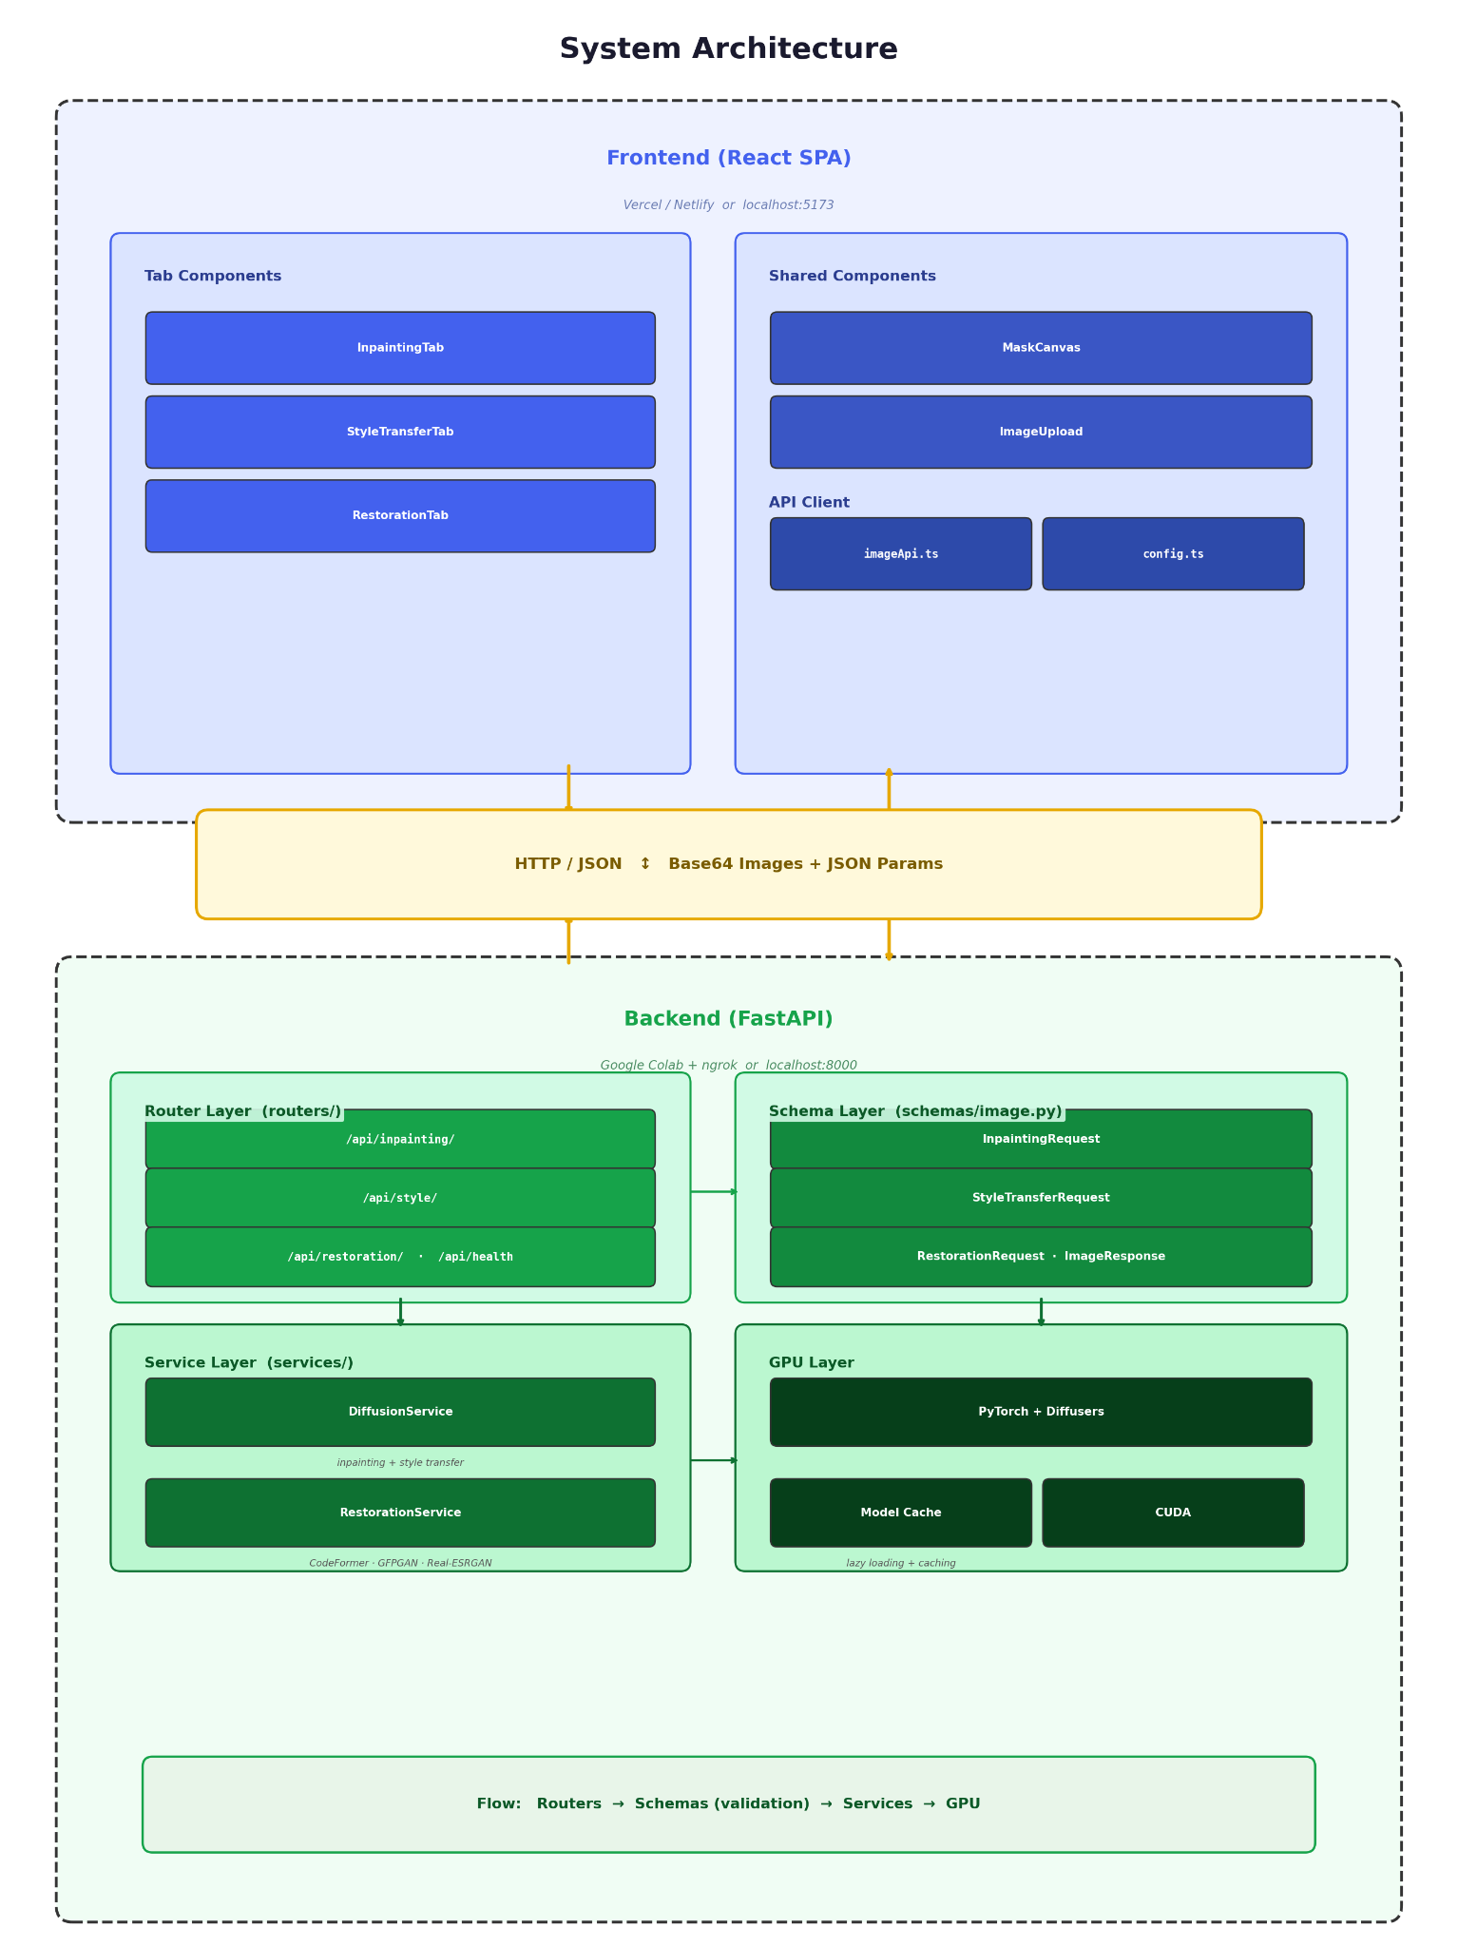
System Architecture
Frontend - React 19 SPA
Backend - FastAPI on Colab GPU, exposed via ngrok
Backend = three layers
routers/ -> endpoint contacts
schema/ -> Pydantic validation
services/ → singleton ML pipelines
Lazy load + cache models per (name, quantisation)
JSON + Base64 transport (no multipart)
Notes:
The system follows a standard client-server SPA plus REST pattern. The frontend is a React 19 SPA, while the backend is FastAPI running on a Colab GPU and exposed publicly through an ngrok tunnel. The backend itself is split into three layers — the routers handle endpoint contracts, the schemas validate inputs with Pydantic, and the services hold the singleton ML pipelines. To deal with the long model loading time, models are lazy-loaded on first request and cached in memory keyed by name and quantisation level — so the cold start of 30 to 60 seconds happens once per session, and every subsequent request is nearly instant. All transport is done in JSON with base64-encoded images — a single self-contained payload that simplifies retries and keeps the API contract clean.

Slide 15
Tech Stack — Why these choices
Layer | Choice | Reason
ML Framework | PyTorch | Diffusers + bitsandbytes are PyTorch-native; HF Hub model availability
Backend | FastAPI | Native async, Pydantic validation, auto-OpenAPI/Swagger, no ORM bloat
Frontend | React 19 + TS + Vite + Tailwind | Modern SPA, type safety, fast HMR
Quantisation | bitsandbytes | NF4/INT8 -> fits FLUX.1 fill on smaller GPU
Deployment | Colab + ngrok | Free GPU + public HTTPS:tunnel
Notes:
On the tech stack, PyTorch was the obvious choice because the Diffusers library and bitsandbytes are both PyTorch-native, and every model i needed already lives on Hugging Face Hub. FastAPI was chosen over Flask or Django because of native async, automatic Pydantic validation, and auto-generated Swagger docs without ORM bloat. On the frontend, React 19 with TypeScript and Vite gives me type safety end-to-end and fast hot-module reload. The bitsandbytes quantisation choice is the linchpin of the whole stack — without it, FLUX.1 Fill simply does not run on free Colab.

Slide 16
Live Demonstration
05
Notes:
Now moving onto the live demonstration. I will walk through the three main features — inpainting, style transfer, and restoration — using pre-loaded test images on the running web application. The Colab backend is already pre-warmed with the lighter models so we don't have to wait on cold starts.
DEMO 1 — INPAINTING (Object Removal). I'm uploading a photo of a single rowboat on a calm lake at dusk. Using the brush tool, I will mask both the boat and its dark reflection in the water — masking only the boat would leave the reflection as a giveaway. With the SD Inpainting model selected and the prompt 'calm empty lake water at sunset, smooth reflection, peaceful', I click Generate. While the request runs, the React frontend sends a base64 JSON payload to FastAPI on Colab. The backend decodes it, runs a 30-step DDIM denoising loop on the masked latent, and returns the result. Here you can see the boat and its reflection have been replaced with continuous water — a clean object removal demonstrating SD Inpainting's ability to fill the masked region using surrounding context.
DEMO 2 — STYLE TRANSFER (Cyberpunk). Next, I switch to the Style Transfer tab and upload a photo of a snow-capped mountain in fog. I select the Cyberpunk preset. One important adjustment here — the cyberpunk style is semantically very far from a mountain landscape, so at the default strength of 0.6 the model would reinterpret the scene too aggressively, often turning it into a cityscape. I am lowering strength to 0.4 and guidance scale to 5.0, which keeps the mountain silhouette anchored while still injecting the cyberpunk colour palette. Click Generate. The result preserves the same mountain composition but reinterpreted with neon accents and vibrant colours — a useful illustration of how the strength parameter trades off between style intensity and composition preservation.
DEMO 3 — RESTORATION. Finally, I switch to the Restoration tab and upload a vintage sepia portrait of two women — with visible scratches, faded edges, and soft focus. I select CodeFormer with fidelity 0.5, and 2x upscale via Real-ESRGAN as the background upsampler. No prompt is needed — restoration uses non-diffusion models that are optimised for the inverse problem of recovering existing detail rather than generating new content. CodeFormer's face-detection step finds both faces independently, enhances each one through the VQ codebook, and pastes them back onto the Real-ESRGAN upscaled background. In a few seconds we see both faces sharpened with eyes, hair, and mouth detail recovered, while the original sepia tone and aged character of the photograph are preserved.
That concludes the live demonstration. All three features ran successfully on the free Colab T4 in under a minute each. Now back to the slides for the results discussion.

Slide 17
Results & Evaluation
06
Notes:
With the demo completed, moving onto the results and evaluation section.

Slide 18
Inpainting Results - 4 test cases
Test | Model | Outcome
Beach scene — remove crowd | SD Inpainting | Good blend, minor sand artefacts
Vintage Car — cobblestone road | SDXL inpainting | Sharp, perspective-consistent
Mountain peak — blue sky | FLUX.1 Fill | Cleanest mask boundary
Coastal grasses — ocean | Kandinsky 2.2 | Document colour mismatch
Notes:
Across four representative test cases, FLUX.1 Fill consistently produced the cleanest mask boundaries — the mountain peak case shows zero visible seam between the generated sky and the surrounding rock. SDXL handled the larger mask cases like replacing the vintage car with a cobblestone road, with sharp and perspective-consistent fills. SD 1.5 was the workhorse for the simpler removal — clearing the beachgoers from the sand. Kandinsky 2.2 surfaces a documented limitation here: its CLIP image-prior architecture prioritises semantic plausibility over pixel-level coherence with the surrounding region, so when i asked it to fill grasses with ocean water, the colours don't quite match at the boundary. I am reporting this openly in the report rather than cherry-picking the results.

Slide 19
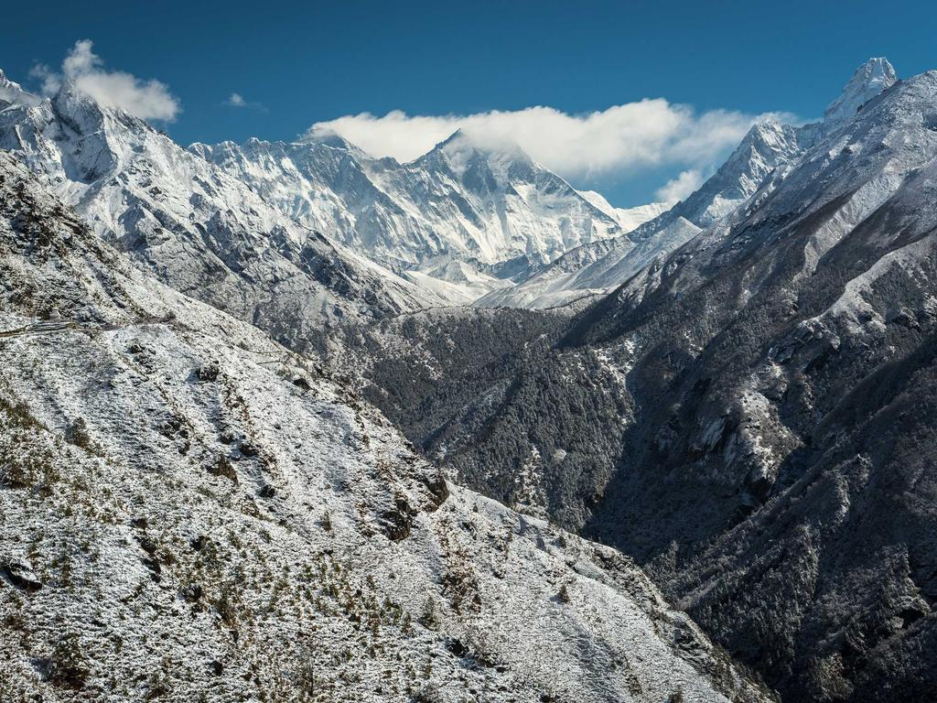
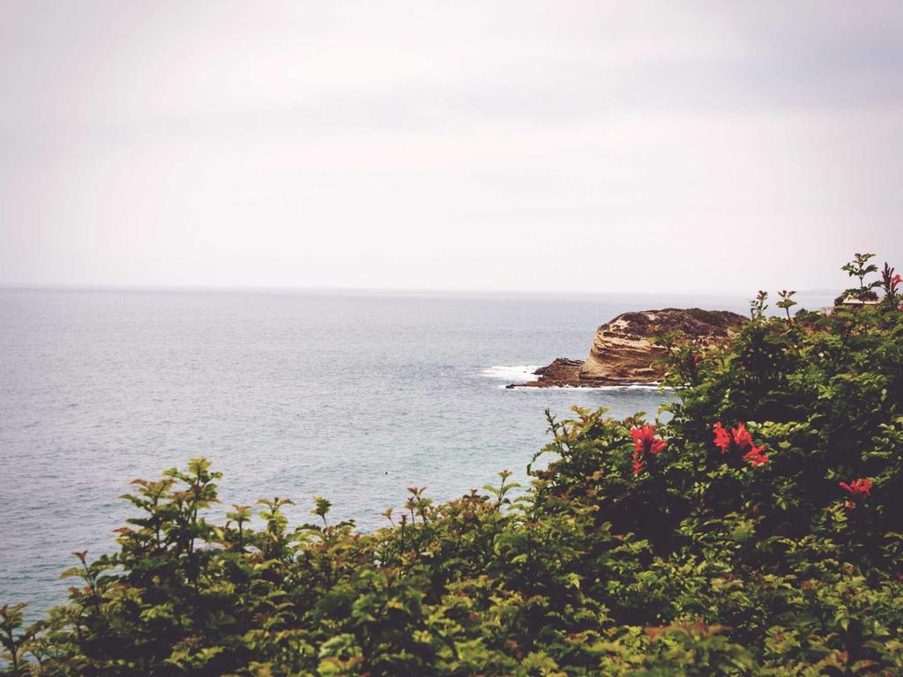
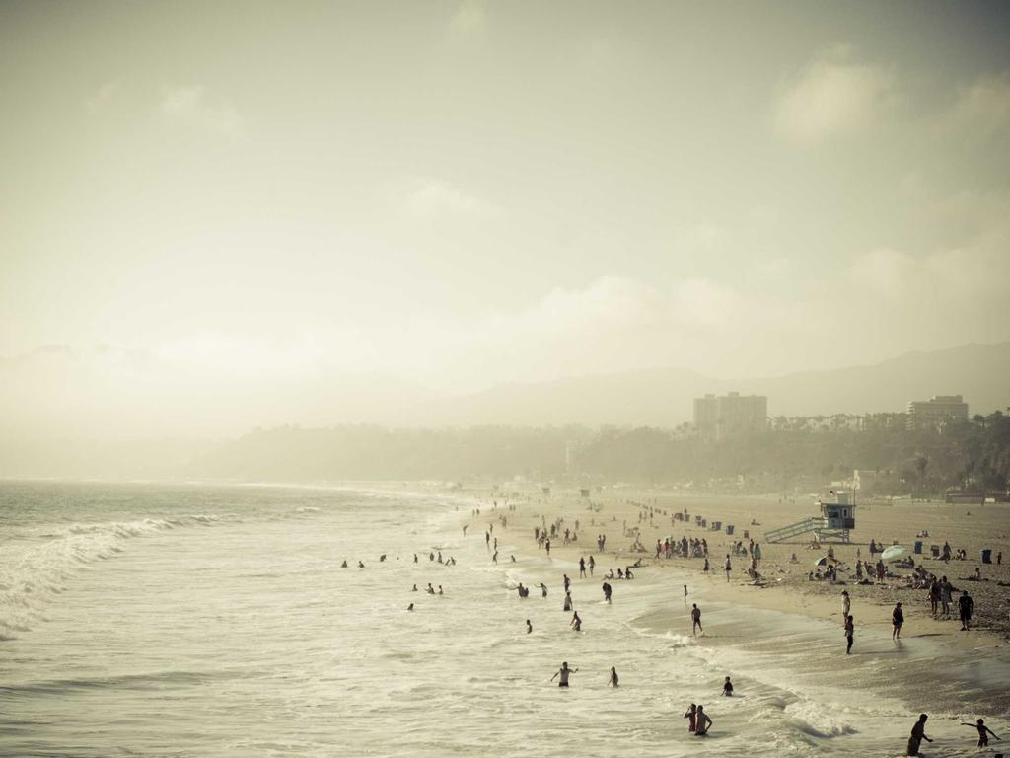
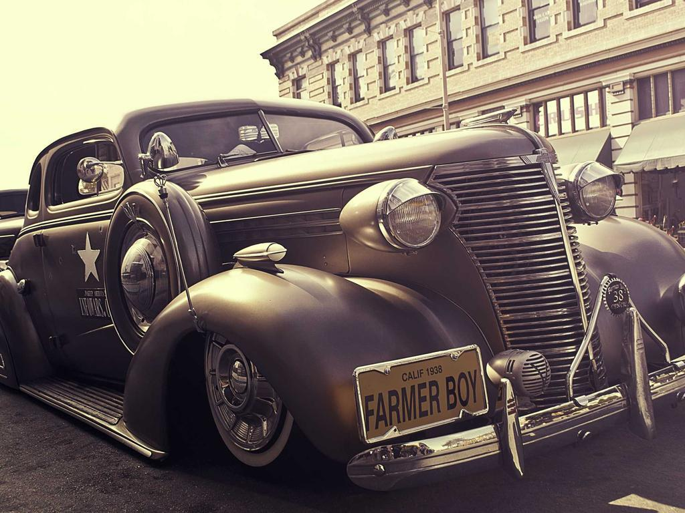
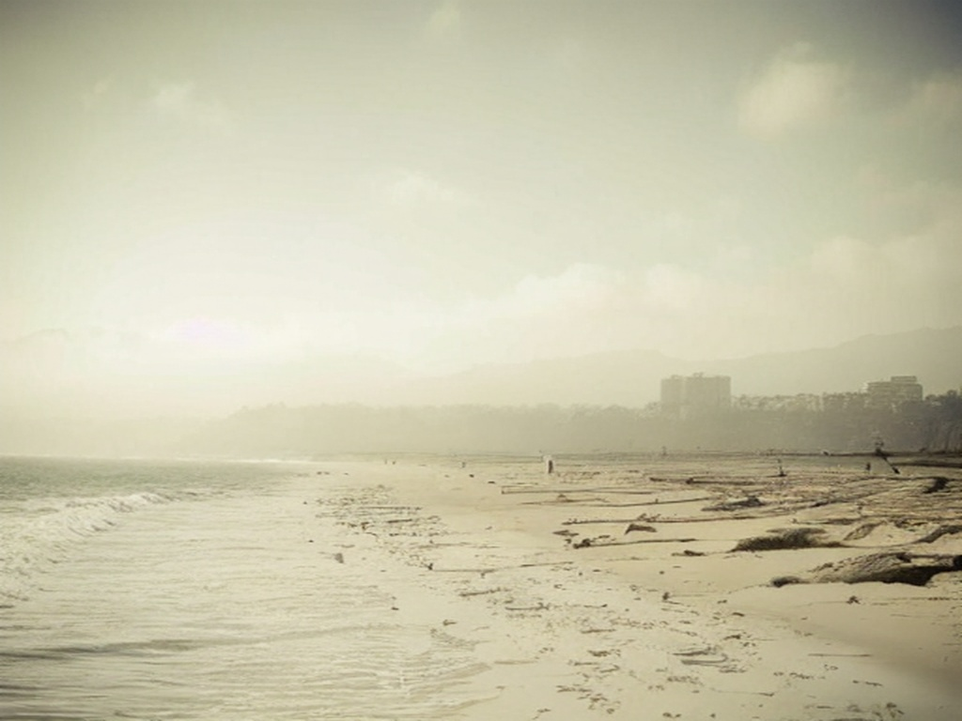
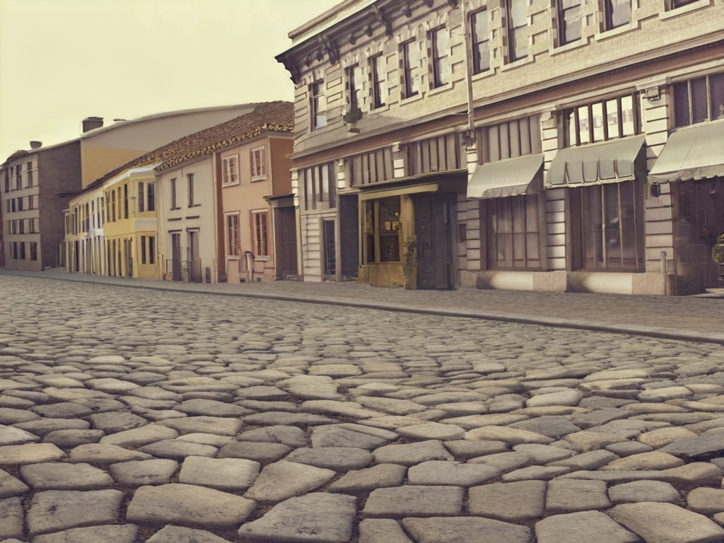
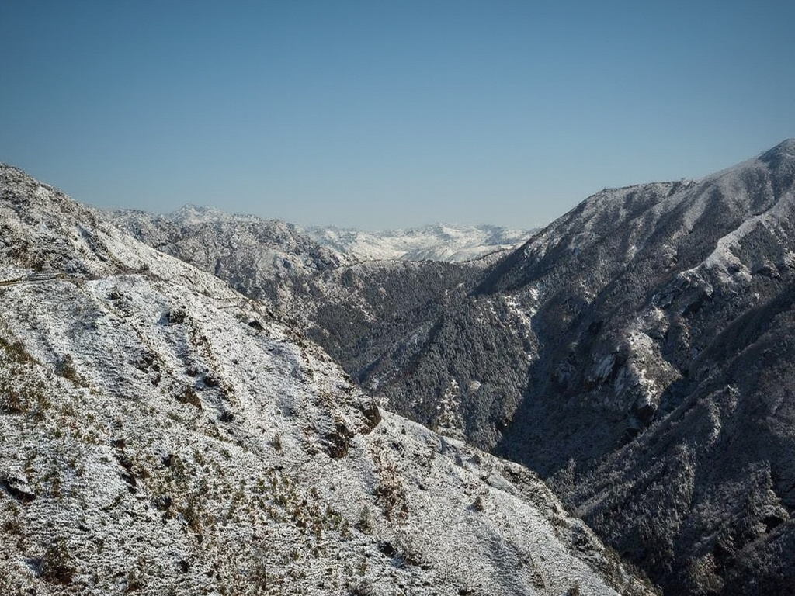
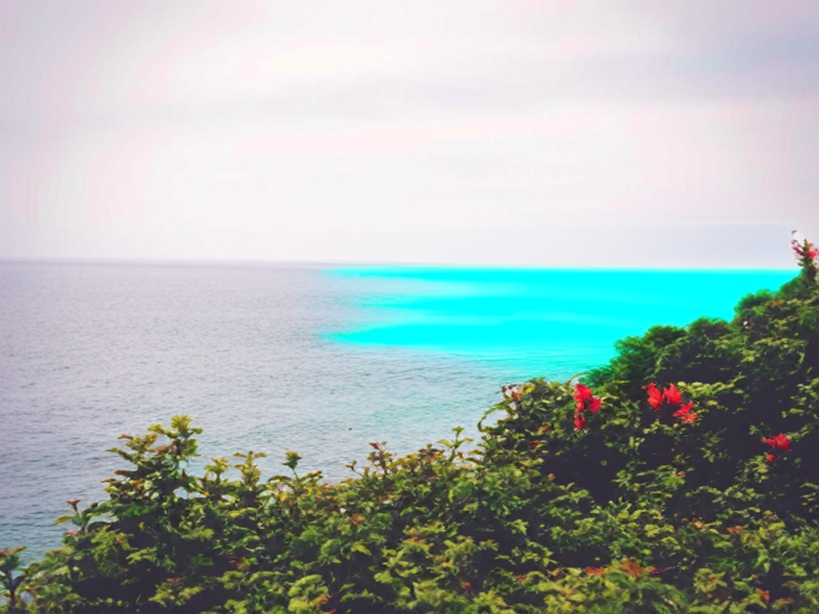
Inpainting – Visual examples
Notes:
For visual evidence on the inpainting feature, here are the side-by-side before and after results. As mentioned, FLUX.1 Fill blends seamlessly across the mountain peak boundary even at 4-bit NF4 quantisation, while Kandinsky's colour mismatch is visible at the coastal grasses example.

Slide 20
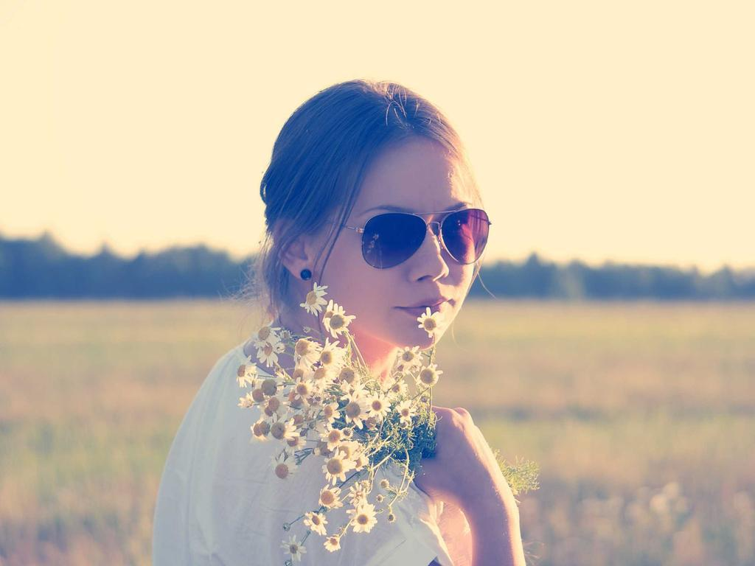
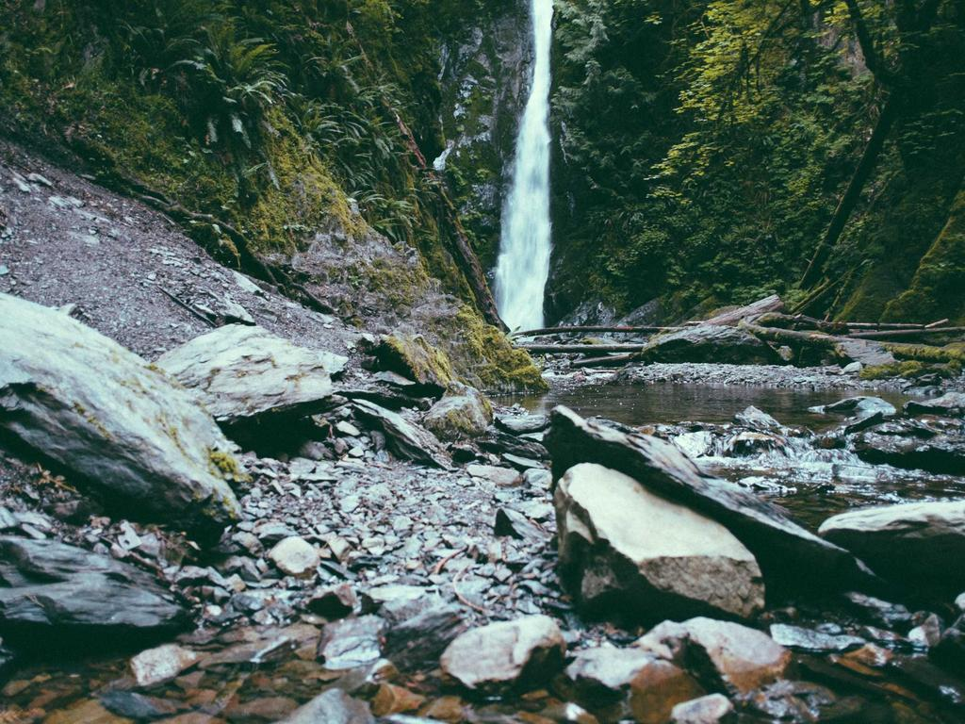
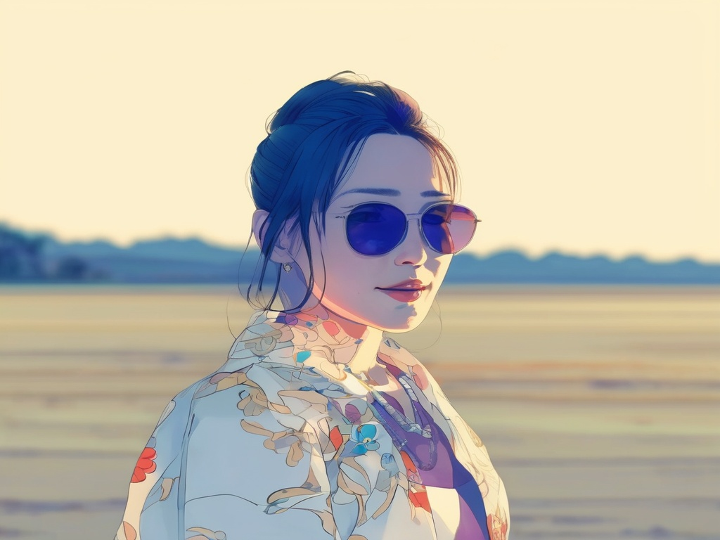
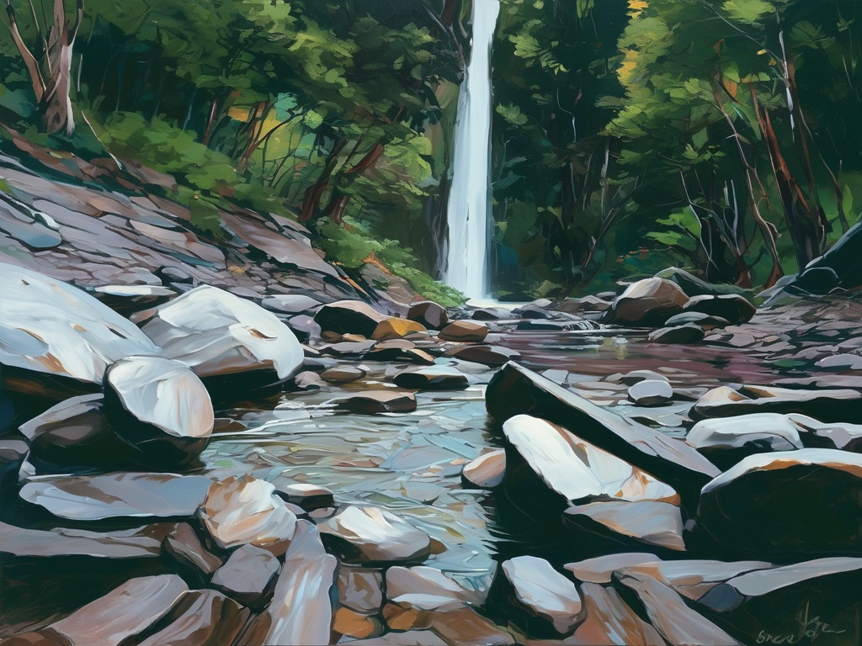
Style Transfer — Visual examples
SDXL img2img, str 0.6
(Anime)
SDXL img2img, str 0.6
(oil)
Notes:
For style transfer, both test cases use SDXL img2img at strength 0.6. The portrait converted to anime preserves the subject's pose, sunglasses, and clothing while transforming the aesthetic — the composition stays intact. The landscape converted to oil painting shows convincing brushstrokes and impasto-like texture, but the mountains and waterfall remain in the same positions. This is the strength of img2img — composition is preserved while only the style is transformed.

Slide 21
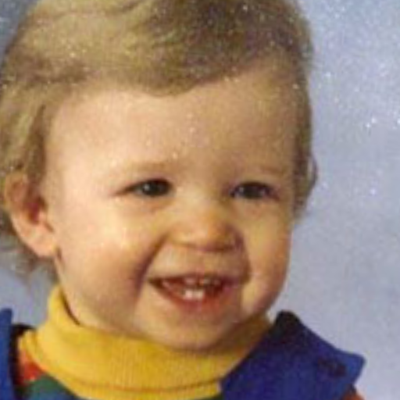

Restoration— Visual examples
CodeFormer fidelity 0.5 + Real-ESRGAN 4x
Notes:
For restoration, the toddler face shows what CodeFormer paired with 4x Real-ESRGAN can do. Facial features sharpen, the resolution quadruples, and the subject is still recognisable as the same person. Fidelity 0.5 was the sweet spot here — high enough quality, with strong identity preservation.

Slide 22
Performance benchmarks
task | Model | Time(s) | VRAM(GB)
Inpaint | SD 1.5 Inpainting | 8-12 | ~5
Inpaint | SDXL Inpainting (4 bit) | 15-25 | ~6
Inpaint | Kandinsky 2.2 | 10-15 | ~7
Inpaint | FLUX.1 Fill(NF4) | 30-50 | ~10
Style | SDXL img2img (4-bit) | 12-20 | ~6
Restore | CodeFormer + ESRGAN 2x | 5-10 | ~4
Restore | GFPGAN + ESRGAN 2x | 3-8 | ~4
Notes:
Looking at performance, all seven configurations complete a single inference in under a minute on the free Colab T4. SD 1.5 inpainting is the fastest at 8 to 12 seconds, while FLUX.1 Fill is the slowest at 30 to 50 seconds — which is why i avoid demoing it live, but it does produce the highest quality results. The lightweight restoration models run in 3 to 10 seconds, which makes the app feel responsive for the most common use cases. The headline number here is the FLUX.1 Fill row — 10 gigabytes of VRAM after NF4 quantisation, fitting comfortably within the free 15 gigabyte tier.

Slide 23
Difficulties and future work
07
Notes:
Moving onto the difficulties faced and the future work.

Slide 24
Difficulties & Learning Outcomes
Top 3 Difficulties Solved:
GPU Memory
bitsandbytes NF4/INT8 + attention slicing + CPU offload
Model loading latency (30 - 60s)
In memory cache keyed by (model, quant)
Canvas coordinate-scaling
Cavas scale factor + Resizeobserver
Key Learning Outcomes:
Practical diffusion model inference
Quantisation engineering
Fullstack ML deployment
Notes:
Three difficulties stood out and shaped the architecture. Firstly, GPU memory constraints — the free Colab T4 only has 15 gigabytes, while FLUX.1 Fill needs 24. I solved this through layered quantisation — bitsandbytes NF4 plus attention slicing plus CPU offload. Secondly, model loading latency, which takes 30 to 60 seconds — solved with an in-memory cache keyed by model name and quantisation, so users only pay that cost once per session. Thirdly, the canvas coordinate scaling — a small but stubborn UI bug solved with a canvasScale factor and a ResizeObserver. Beyond the deliverables, the most valuable thing i take away from this project is hands-on experience with practical diffusion model inference, quantisation engineering, and full-stack ML deployment.

Slide 25
Future Work
Text to image generation
User Auth + History
Persistent deployment
ControlNet integration
Notes:
For future work, four extensions stand out. Text-to-image generation is the most natural next step since the inference infrastructure already exists. ControlNet integration would add edge, depth, or pose conditioning for finer spatial control. User authentication with editing history would unlock real-world workflows. And replacing ephemeral Colab with a persistent GPU host would make this production-deployable.

Slide 26
Thank you !
Notes:
That brings me to the end of my presentation. Thank you for listening — i'm happy to take any questions.

